Slide 1

Hands-on Implementation of Deep Learning
The Rising Science

Slide 2
Agenda
01
Introduction
What is Deep Learning?
02
Applications of Deep Learning
Practical applications and products of DL
03
Types of DL
Different paradigms of DL
04
Implementation of Deep Learning
The DL algorithms and practical implementation of DL

Slide 3




Ehtisham Raza
I am AI/ML Engineer working in a FinTech having 3+ years of experience and solving financial problems using artificial intelligence and machine learning.
Ehtisham Raza
AI/ML Engineer at Finja
Data Trainer & Coach at AnalystsHQ
Ehtisham Raza

Slide 4
Introduction
What is Deep Learning?

Slide 5

Deep Learning
Deep learning is a branch of AI focused on training complex neural networks to automatically learn and recognize patterns in data, enabling machines to perform tasks without explicit programming. It excels in tasks like image and speech recognition by capturing hierarchical features through multiple layers.

Slide 6
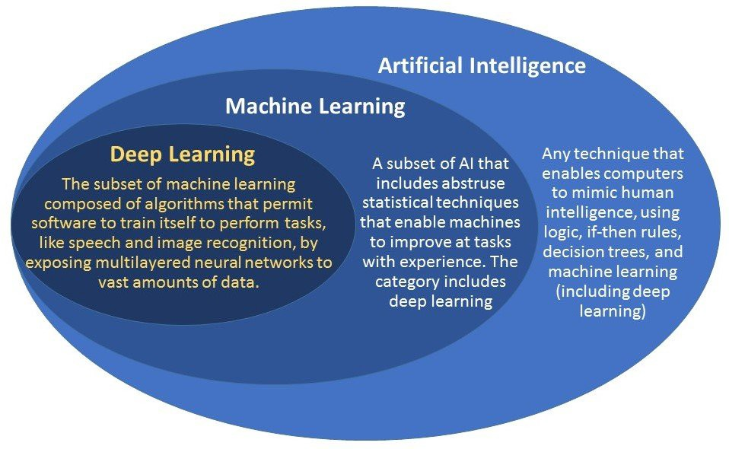
AI Approaches

Slide 7
DL vs ML
Deep learning | Machine Learning
Best suited for large datasets | Best suited for small datasets
Best suited for data having large number of features | Best for data with small number of features
Feature Engineering is Automatic | Feature engineering is manual
Require specific and costly hardware to process | Can work with ordinary machines
More generalizable than ML methods | Less generalizable than DL methods
Can perform multiple tasks at same time. I.e. object detection and recognition | Each task is performed separately
DL methods take more time to train | ML methods take less time to train
DL methods are less understandable | ML methods are more understandable
DL methods provide better performance | ML methods lag behind in performance

Slide 8
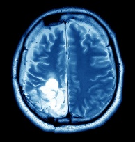
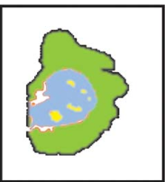
Deep Learning Pipeline
Image Acquisition & Data Collection
Preprocessing
Segmentation and Classification
DL Model Definition
Optimization
Performance Evaluation

Slide 9
Type of Deep Learning
Like ML, there are three types of Deep Learning
Supervised Learning
Unsupervised Learning
Reinforcement Learning
Transfer Learning

Slide 10
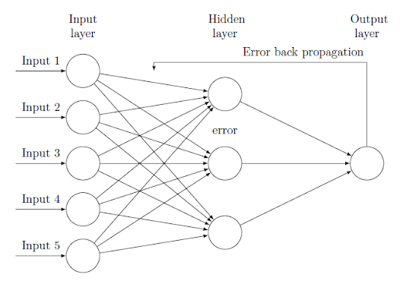
DL Working
DL models work in iterative manners
Three basic steps in supervised learning
Forward pass
Loss calculation
Backward pass

Slide 11
DL Algorithms
These are the algorithms of the Deep Learning:
Convolutional Neural Network (CNN)
Recurrent Neural Network (RNN)
Generative Adversarial Networks (GANs)
Autoencoders
Gated Recurrent Units (GRUs)
Long Short-Term Memory (LSTM)
Deep Reinforcement Learning
Self-Organizing Maps (SOMs)

Slide 12
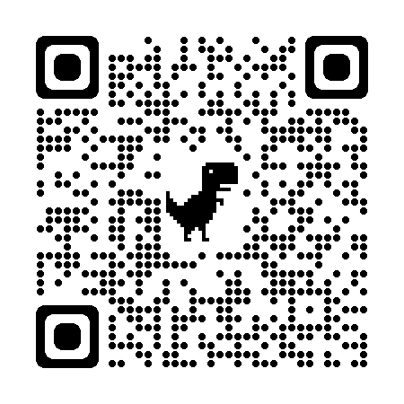
Webinar Content

